Slide 1

Network and Computer Security
BlingBank
Group 43
99300 Pedro Rodrigues
99340 Tomás Marques
102314 Renato Martins

Slide 2
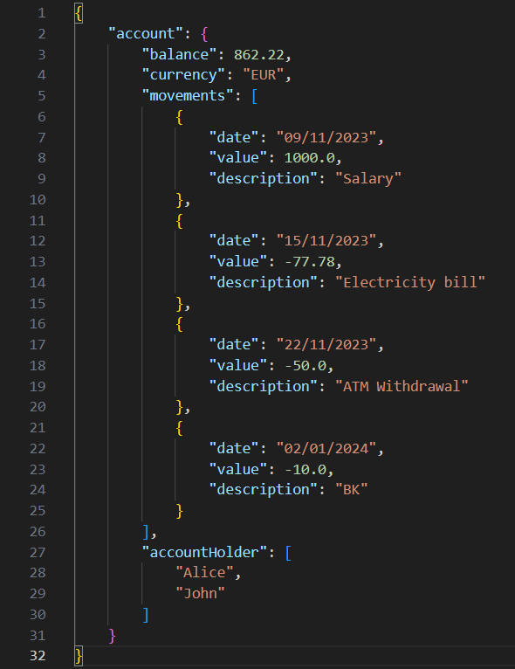
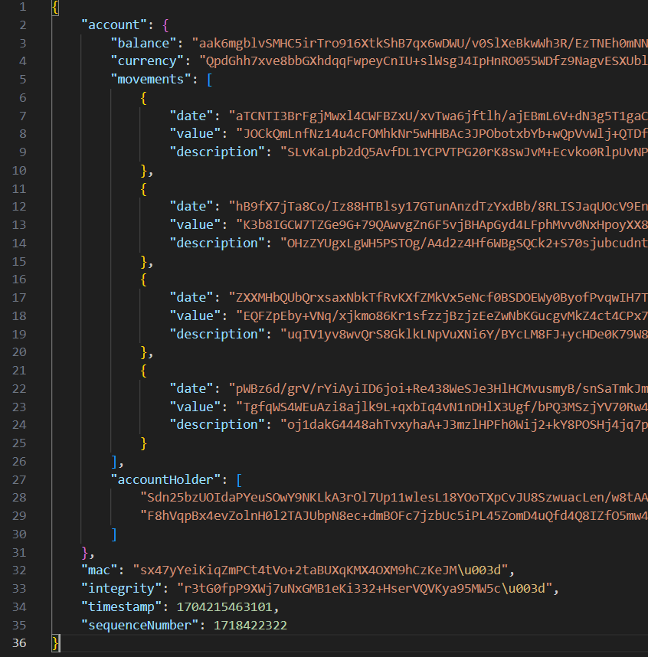
The Secure Document Format
Advanced Encryption Standard (AES) in Galois/Counter Mode (GMC)
Digital Signatures using RSA (asymmetric criptography)

Slide 3
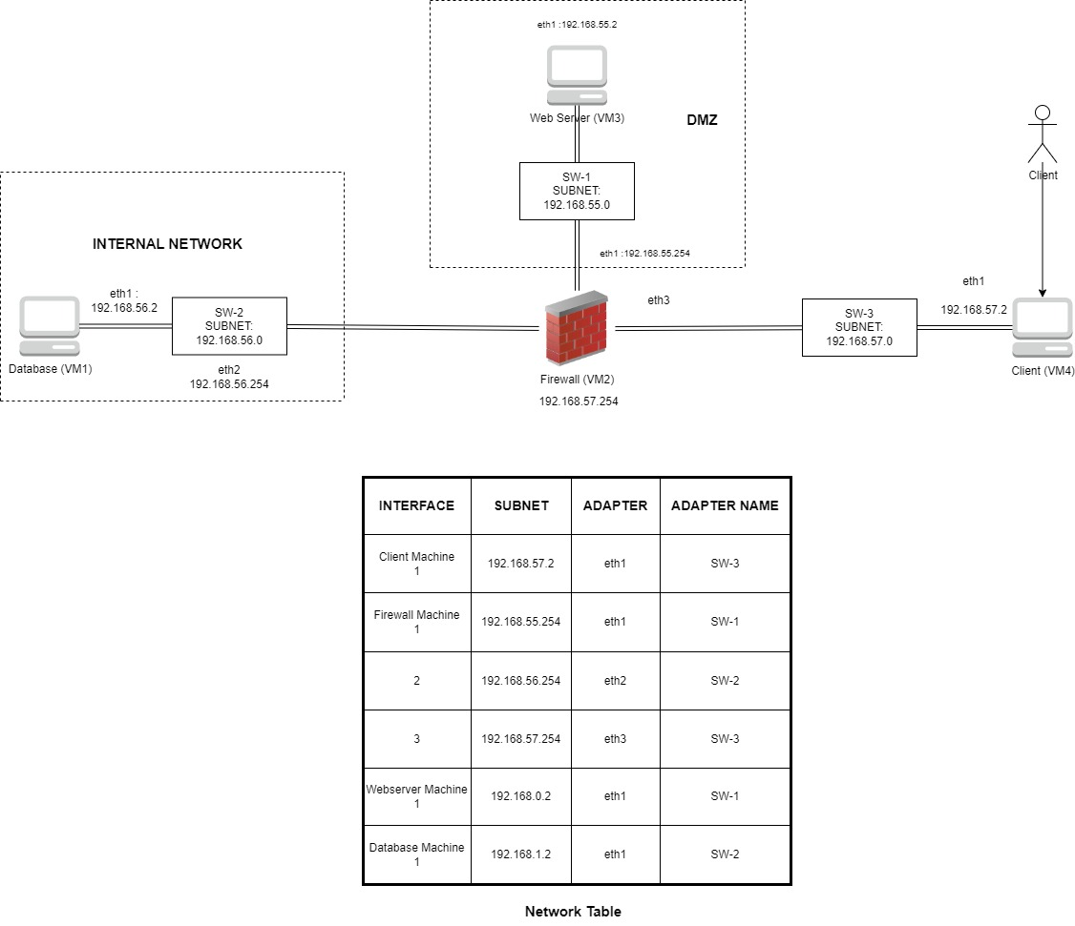
Infrastructure

Slide 4
Secure Channels and Key Distribution
Dynamic key distribution system that regularly updates user keys
TLS Secure Sockets between client and server entities
Mutual Authentication to ensure confidentiality
Servers and Client have own certificate and private key save in the keystore
Each entity have other entity certificate and CA certificate in the truststore
Each entity validates the other certificate chain with the CA’s certificate
Key Distribution
Client | Server
Server | Database

Slide 5
Security Challenge
Introduce a new document format for payment orders ensuring confidentiality, authenticity and non-repuditation
Implement robust freshness measures to prevent duplicate executions of the order
Require authorization and non-repudiation from all owners of an account with multiple owners

Slide 6
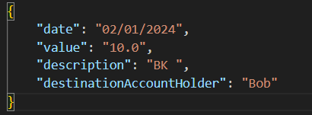
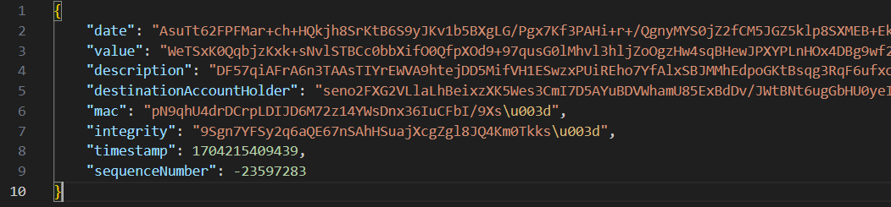
Security Challenge
Introduce a new document format for payment orders ensuring confidentiality, authenticity and non-repuditation

Slide 7
Security Challenge
Implement robust freshness measures to prevent duplicate executions of the order
UNIQUE SEQUENCE NUMBER AND TIMESTAMP FOR EACH TRANSATION AND SERVER VERIFICATION

Slide 8
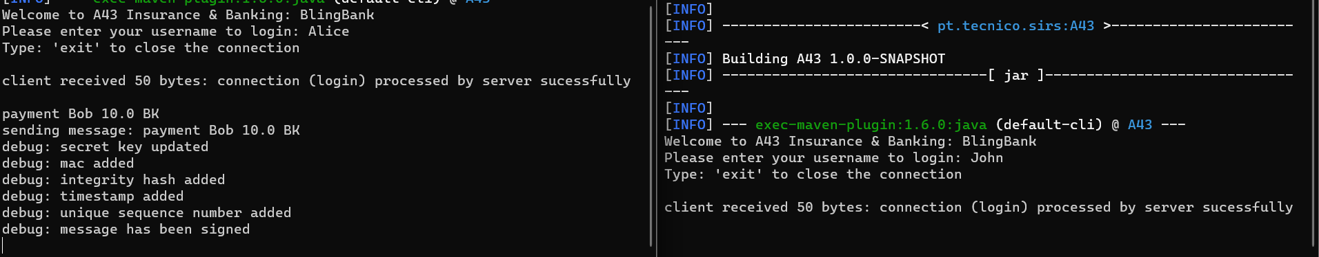
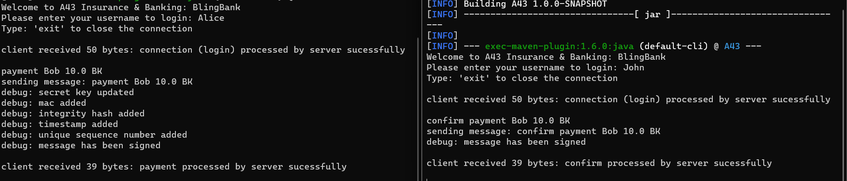
Security Challenge
Require authorization and non-repudiation from all owners of an account with multiple owners
SIGNATURE OF EACH TRADED MESSAGE ENSURE NON-REPUDIATION

Slide 9
Main Results and Conclusions
The security framework implemented in the project is a robust and comprehensive solution
Recognize the inherent impossibility of complete security
One potential improvement is introducing secure and encrypted password for each client stored in database while account creation

